Slide 1
CLOUD GAMING: MULTIPLAYER GAMES(Amazon's Gamelift and Microsoft's Playfab)
Presented by: Saurabh Yadav & Shobhit Verma

Slide 2
What is Cloud ?
The "Cloud" refers to a network of servers, typically hosted on the internet, that store, manage, and process data and applications.
These servers are often housed in data centers around the world.
The term "Cloud" is derived from the use of a cloud symbol to represent the complex infrastructure it comprises in diagrams and presentations.

Slide 3
What is Cloud Computing?
Cloud computing is the on-demand access of computing resources—physical servers or virtual servers, data storage, networking capabilities, application development tools, software and more—over the internet with pay-per-use pricing.
The cloud computing model offers:
Cost Effectiveness
Speed and Agility
Scalability
Strategic Value
Reliability
Security
Notes:
The "cloud" refers to the infrastructure itself, while "cloud computing" refers to the delivery of computing services over the internet using that infrastructure.
Cloud computing plays a pivotal role in our everyday lives, whether accessing a cloud application like Google Gmail, streaming a movie on Netflix or playing a cloud-hosted video game.

Slide 4
What is Cloud Gaming ?
Cloud gaming, also known as game streaming or gaming-as-a-service, is a gaming service that allows users to play video games over the internet without the need for dedicated gaming hardware. Instead of running games on a local device like a gaming console or PC, cloud gaming platforms use powerful servers located in data centers to run games remotely.

Slide 5
How Cloud Gaming Works
Server-Side Processing: Initiate a game session, inputs are sent to remote servers. These servers then process the inputs and run the game.
Video Streaming: Gameplay footage is then encoded into a video stream and sent back. This video stream is typically compressed to reduce latency and bandwidth requirements.
User Interface: On user's device, the video stream is decoded and displayed on the screen, allowing the player to see and interact with the game. The user's inputs are sent back to the servers, completing the loop.

Slide 6
WebRTC (Web Real Time Communication)
WebRTC is a free and open-source project providing real-time communication (RTC) via APIs. It allows audio and video communication and streaming to work inside web pages by allowing direct P2P communication.
Purpose: To "enable rich, high-quality RTC applications to be developed for the browser, mobile platforms, and IoT devices, and allow them all to communicate via a common set of protocols".
WebRTC serves multiple purposes; together with the Media Capture and Streams API, they provide powerful multimedia capabilities to the Web.
Devices can share voice, video, and real-time data smoothly and securely among one another on a common platform. WebRTC is the future of real-time communication.

Slide 7
Why WebRTC?
WebRTC doesn’t require any additional plugins or applications for audio, video streaming and data sharing.
It uses JavaScript, APIs and HTML5 for the communication technologies.
Products like Google Hangouts, Whatsapp, Facebook Messenger, ZOOM Team Communication, Zendesk Customer Support, Skype for Web etc. all are integrated with WebRTC.
Browsers are able to directly exchange real-time media with other browsers in a P2P manner.
Offers a high level of security than various other streaming systems, without the need for third-party software.
It is available for free and is operated worldwide.

Slide 8
WebRTC Working
WebRTC works and communicates with web browsers through the standardized WebRTC API.
The WebRTC API must, therefore, provide a range of utilities. Some of them are like connection management, encoding/decoding, media control etc.
The scope of implementation in WebRTC is very high as it is highly customizable.
MediaStream: The stream that user want, the mode of communication to establish is captured. Local media stream grants the browser to have access to stream devices such as the camera, web microphone. It also allows the browser to capture media. getUserMedia() function: the access from the browser.
RTCPeerConnection: Connect user with the partner’s system. It allows your browser to exchange data directly with partner browsers (peers) for voice and video calls. It allows the association between the sender and the receiver.
RTCDataChannel: It grants the browsers to exchange data bidirectional peer-to-peer. CreateDataChannel() is called for the first time on an instantiated PeerConnection object.

Slide 9
WebRTC Transmit Data - Connection
function createConnection() {
dataChannelSend.placeholder = "";
const servers = null;
window.localConnection = localConnection = new RTCPeerConnection(servers);
console.log("Created local peer connection object localConnection");
sendChannel = localConnection.createDataChannel("sendDataChannel");
console.log("Created send data channel");
localConnection.onicecandidate = (e) => {
onIceCandidate(localConnection, e);
};
sendChannel.onopen = onSendChannelStateChange;
sendChannel.onclose = onSendChannelStateChange;
window.remoteConnection = remoteConnection = new RTCPeerConnection(servers);
console.log("Created remote peer connection object remoteConnection");
remoteConnection.onicecandidate = (e) => {
onIceCandidate(remoteConnection, e);
};
remoteConnection.ondatachannel = receiveChannelCallback;
localConnection
.createOffer()
.then(gotDescription1, onCreateSessionDescriptionError);
startButton.disabled = true;
closeButton.disabled = false;
}

Slide 10
Limitations & Future
One must have access to a fast internet connection to communicate with WEBRTC.
It does not offer any offline services.
It is not available in all the browsers.
There is no fixed service providing a base for every browser.
WebRTC is currently improving the quality of video calling in case of poor connection or slow internet access.
Soon WebRTC will become the standard for the companies which offer customer service.
It will be the future of business communication.

Slide 11
Benefits of Cloud Gaming
Accessibility: Players can access high-quality games on various devices such as smartphones, tablets, laptops, and smart TVs.
No Downloads or Installations: Stream games directly from remote servers. This eliminates the need for large downloads and installations.
Instant Play: Once you subscribe to a cloud gaming service, you can start playing games immediately, without waiting for downloads or updates. This makes it convenient for gamers who want to jump into a game quickly.
Wide variety of games: Ranging from popular AAA titles to indie games. Subscribers usually have access to a library of games that they can play on-demand, often for a monthly subscription fee.
Notes:
The "cloud" refers to the infrastructure itself, while "cloud computing" refers to the delivery of computing services over the internet using that infrastructure.
Cloud computing plays a pivotal role in our everyday lives, whether accessing a cloud application like Google Gmail, streaming a movie on Netflix or playing a cloud-hosted video game.

Slide 12
Continued...
Cross-Platform Play: Supports cross-platform play, allowing players to access their game progress and achievements across multiple devices.
Scalability: Highly scalable, meaning they can accommodate many players simultaneously without compromising performance.
Improved Hardware Utilization: Cloud gaming platforms can leverage powerful server hardware to deliver high-quality gaming experiences. By offloading the processing and rendering tasks to remote servers, cloud gaming can provide smooth gameplay.
Future potential: Cloud gaming is still a relatively young industry, and there is significant potential for growth and innovation.
Notes:
As is the case with streaming platforms like Netflix, cloud gaming services have adopted different video encoding methods. That allows platforms like Shadow or Vortex to adapt the video stream based on your internet speed. If the connection falls below the good speeds for gaming, the video will show more compression artifacts.

Slide 13
Latency & Bandwidth
Latency is used to measure how good your connection is when gaming online. It is mainly a factor of how far a server is from your physical location. The closer you are to the server you’re connecting to, the lower your latency, in most cases.
Bandwidth is the maximum amount of data that can be transferred — doesn’t matter, as you’re only transporting small bits of data. For cloud gaming, though, bandwidth is a key metric.
Notes:
The two factors to consider when talking about cloud gaming are latency and bandwidth. Gamers are likely familiar with latency or, as it’s often referred to, “ping.” Your ping is how long it takes — usually in milliseconds — for an input to be sent across a network in a round trip
Like playing games online, your latency is important in determining how long it takes for your inputs to register. However, unlike playing online, a lot of data needs to be transferred over the network.
Due to the constantly changing nature of gaming, though, that responsiveness can make or break the experience. You need a solid internet connection and close data centers for cloud gaming, there’s no arguing that. However, how quickly the remote computer can respond to your requests is equally as important.

Slide 14
Disadvantages of Cloud Gaming
01
02
03
04
Security of Data
Downtime and Reliability
Dependency on internet
Cost Management Complexities

Slide 15
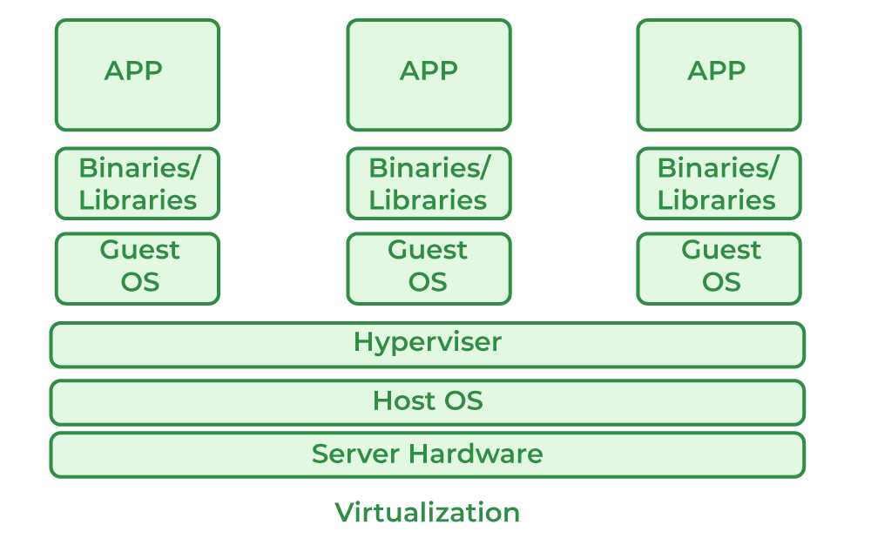
Virtualization
Virtualization is technology that you can use to create virtual representations of servers, storage, networks.
It is the process of creating a virtual version of something like computer hardware.
With the help of Virtualization, multiple operating systems and applications can run on the same machine, same hardware at the same time.
Benefits:
More flexible and efficient allocation of resources.
Remote access and rapid scalability.
Pay peruse of the IT infrastructure on demand.
Enables running multiple operating systems.
Notes:
one of the main cost-effective, hardware-reducing, and energy-saving techniques used by cloud providers is Virtualization.

Slide 16
Concepts of Virtualization
Virtual Machine: A software-defined computer that runs on a physical computer with a separate operating system and computing resources. The physical computer is called the host machine and virtual machines are guest machines. Multiple virtual machines can run on a single physical machine. Virtual machines are abstracted from the computer hardware by a hypervisor.
Hypervisor (Virtual Machine Monitor): A software component that manages multiple virtual machines in a computer. It ensures that each virtual machine gets the allocated resources and does not interfere with the operation of other virtual machines. It manages the execution of multiple operating systems and ensures that each virtual machine operates securely and efficiently.

Slide 17
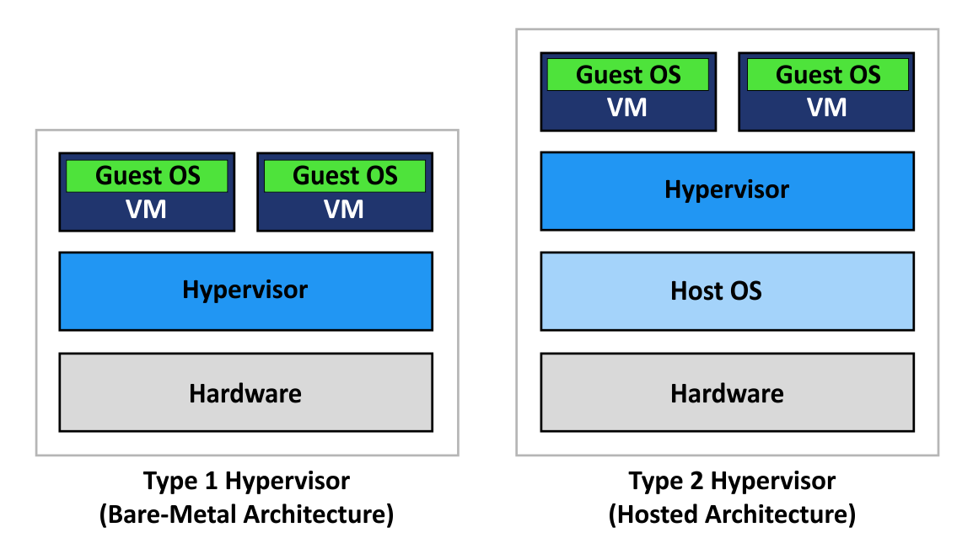

Slide 18
Limitations of Cloud Gaming
Primary Obstacle: Infrastructure, with many services relying on existing data centers or rented cloud space, leading to difficulties in control.
Rushed market entries have plagued previous attempts due to bandwidth limitations.
With support from major tech giants, cloud gaming now boasts improved latency, frame rates, and setup convenience.
Most notably, it offers unparalleled convenience, allowing gameplay across various devices, thus eliminating the need for dedicated hardware. This accessibility is pivotal for future developments, particularly for live-service games, enabling seamless multiplayer experiences without the necessity of owning a console or PC.

Slide 19
A proposed method to improve game streaming's scalability is adaptive graphics processing unit (GPU) resource scheduling. Most cloud gaming providers are using dedicated GPUs to each person playing a game. This leads to the best performance but can waste resources. With better GPU resource scheduling algorithms, if the game does not fully utilize that GPU it can be used to help run someone else’s game simultaneously. GPU virtualization was not used due to the inferior performance of the resource scheduling algorithm. New developments allow up to 90% of the GPUs original power to be utilized.
GPU Resource Sharing

Slide 20
Algorithms could be used to help predict a player's next inputs, which could overcome the impact of latency in cloud gaming applications. Stadia's head of engineering Majd Bakar foresaw the future possibility of using such a concept to " [reduce] latency to the point where it's basically nonexistent", referring to this concept as "Negative Latency".
Predictive Input

Slide 21

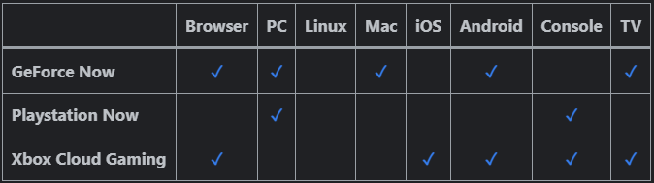
Cloud Gaming Services
Xbox Game Pass Ultimate ( best cloud gaming service overall ) Platforms: PC, Xbox One, Xbox Series X/S, mobile, Web browser, smart TV Resolution: Up to 1080p Network Requirements: 20 Mbps / 10 Mbps Game Library: 450+ Excellent game library Strong stable performance Variety of platforms Expensive monthly fee Robust streaming option at no extra cost Streaming elements can pipe games to all manner of devices

Slide 22
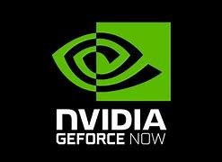

More Cloud Gaming Services
2. Nvidia GeForce Now ( Best budget cloud gaming service )
Platforms: PC, Mac, Chrome OS, Web browser, mobile, smart TV Resolution: Up to 4K Network Requirements: 45 Mbps (recommended) / 15 Mbps (minimum) Game Library: 1,500+
Works with games you own Competent free tier
Uppermost tier is expensive Requires existing accounts and games
3. PlayStation Plus Premium ( best cloud gaming service for PlayStation fans)
Platforms: PC, PS4, PS5 Resolution: Up to 1080p Network Requirements: 15 Mbps / 5 Mbps Game Library: 300+
Sony back catalog Works well on PS4 and PS5 consoles Low bandwidth requirements
PC app condition Tedious save transfer process

Slide 23
Cloud Based Multiplayer Games
Following are some examples of Cloud Based Multiplayer Games:
Fortnite
Apex Legends
League of Legends (LoL)
Call of Duty: Warzone
Minecraft
Rocket league
Player Unknowns Battlegrounds (PUBG)
Rainbow Six Seige
Overwatch
World of Warcraft

Slide 24
Amazon's GameLift
Amazon GameLift is a managed service offered by Amazon Web Services (AWS) that helps developers deploy, operate, and scale dedicated, low-cost servers in the cloud for session-based multiplayer games.
It's designed to simplify the process of setting up server infrastructure for multiplayer games, allowing game developers to focus more on creating engaging gaming experiences rather than managing server infrastructure.

Slide 25
Benefits of Amazon's GameLift
Easy Setup: GameLift simplifies the process of setting up server infrastructure, saving developers time and effort.
Scalability: With GameLift, developers don't need to worry about provisioning and managing servers manually. The service handles scaling up or down based on player demand automatically.
Cost-Effective: GameLift offers a pay-as-you-go pricing model, so developers only pay for the resources they use, making it cost-effective, especially for smaller studios or indie developers.
Security and Reliability: AWS provides robust security measures and a reliable infrastructure, ensuring that game servers are secure and available for players.

Slide 26
Setting up GameLift
Step 1 ) Upload Game Build
A Build in GameLift refers to the compiled version of your game server code that you upload to GameLift. This build is then used to deploy game server instances. This build package should contain:
The executable file for your game server
Any dependencies like libraries or assets needed to run the server
A script to launch the game server executable and any arguments
Any configuration files the game server needs
EC2 Instance:
An EC2 instance in GameLift is a virtual server that runs the game server executable from your build.
The build or script you uploaded is deployed to each EC2 instance in the fleet.

Slide 27
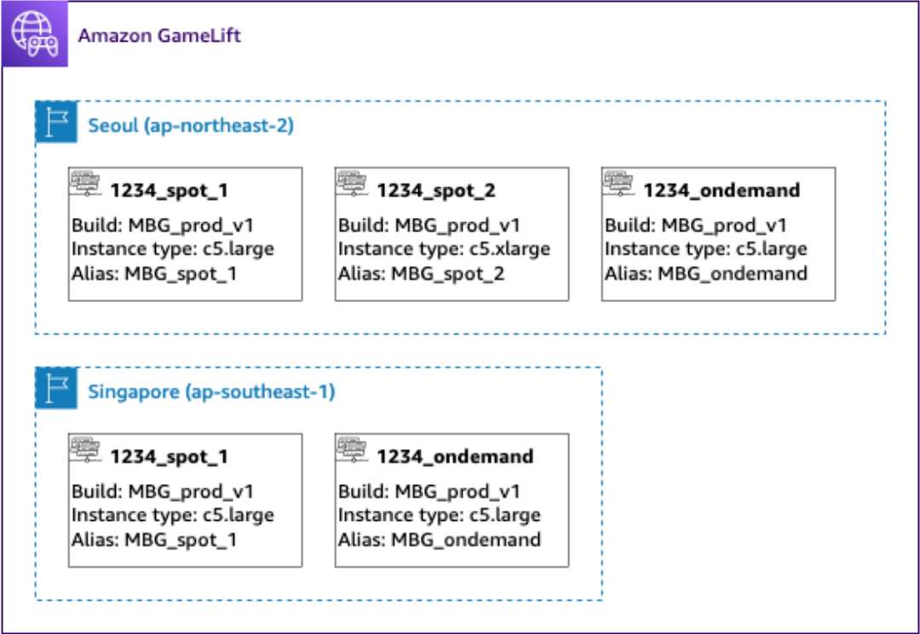
Setting up GameLift
Step 2 ) Create GameLift Fleet
A fleet is a set of EC2 instances that host your game servers. Fleets are created using a specific build. Fleets can be thought of as groups of game servers that are ready to host game sessions.
When creating a fleet, you need to specify:
Fleet name — A unique identifier for the fleet.
Instance type — The EC2 instance type to use for fleet instances. Select based on CPU/memory needs.
Min/max fleet size — The minimum and maximum number of instances to scale between.
Build ID — The S3 location of the game server build package to deploy.
Location(s) – to deploy instances to.
Runtime configuration — Commands to launch the game executable on fleet instances.
Permissions — Allow inbound traffic on game ports.

Slide 28
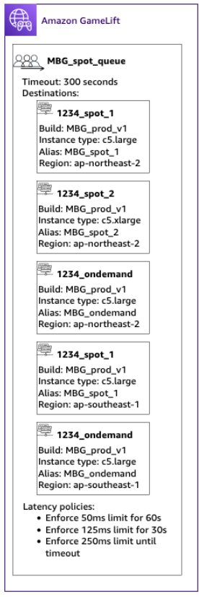
Setting up GameLift
Step 3) Configure Game Queue Setting
A GameLift queue is a mechanism that directs incoming player session requests to the most suitable game server instances across multiple fleets and regions using several factors .
Need?
Our game's player population might have groups of players who shouldn't play together. Like if you publish your game in two languages each language should have it's own game
Servers.
Some common ways to scope queues include:
• By geographic locations: When deploying your game servers in multiple geographic areas, you might build queues for players in each location to reduce player latency.
• By build or script variations: If you have more than one variation of your game server, you might be supporting player groups that can't play in the same game sessions. For example, game server builds or scripts might support different languages or device types.
• By event types: You might create a special queue to manage games for participants in
tournaments or other special events.

Slide 29
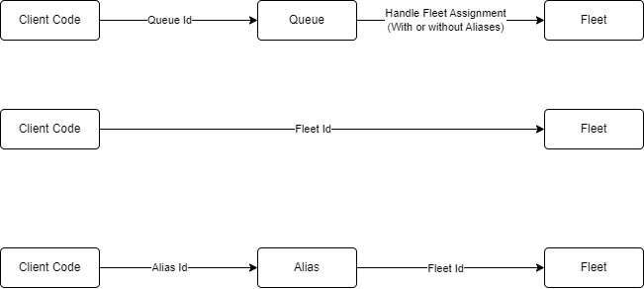
Setting up GameLift
Step 4) Assign aliases Aliases abstract fleet identities, making periodic fleet replacement efficient by seamlessly switching player traffic from one fleet to another by changing the alias's target location. In Game using Queues switching fleets is a simple matter of creating a new fleet, adding it to the queue, and removing the old fleet, none of which is visible to players.
In contrast, game clients that don't use queues must specify which fleet to use when communicating with the Amazon GameLift service. Without aliases, a fleet switch requires updates to your game code and possibly distribution of an updated game clients to players.

Slide 30
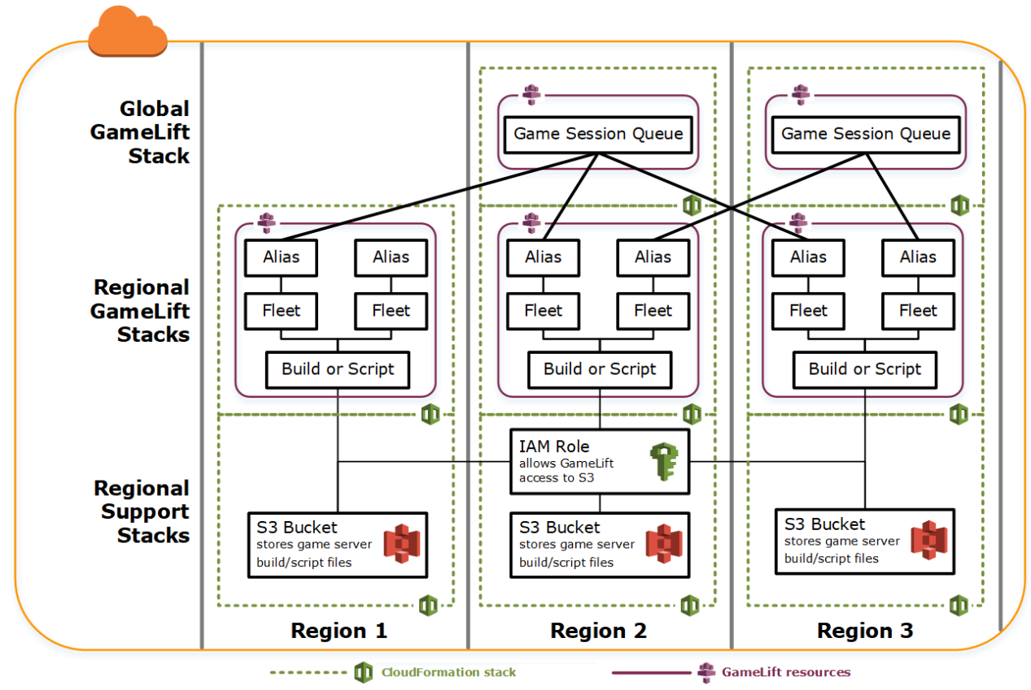
Setting up GameLift

Slide 31
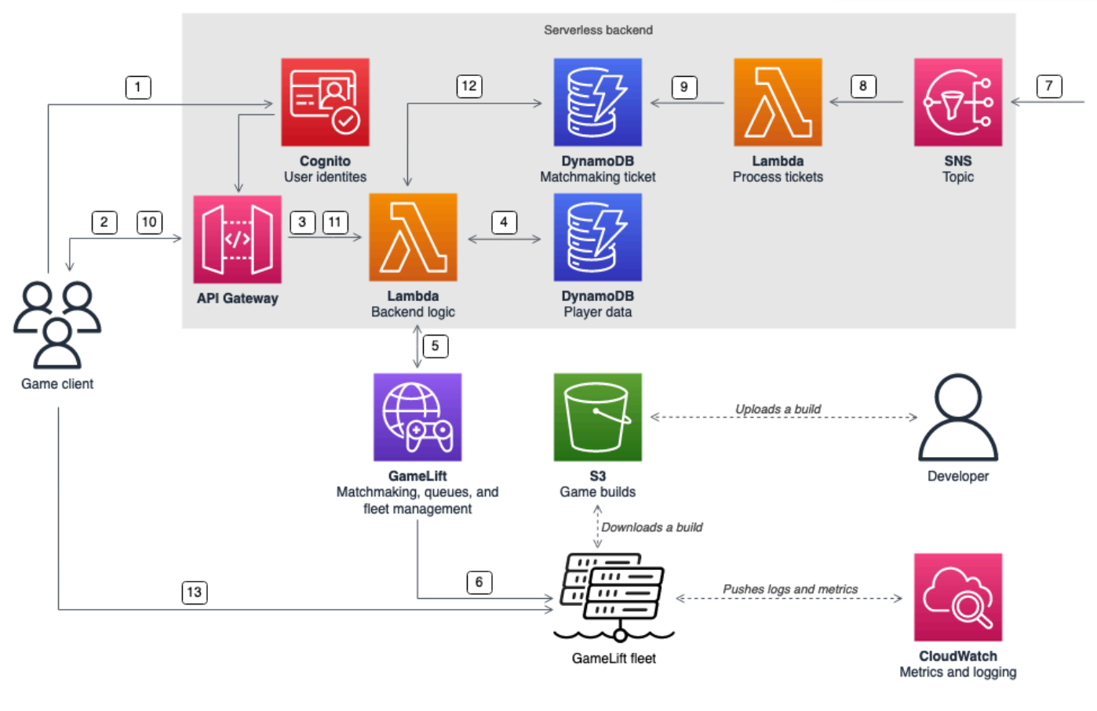
Architecture of GameLift
Game client requests an Amazon Cognito identity from a Cognito Identity Pool. Optionally, this can be connected to external identity providers such as Google, Apple, Xbox Live, and Steam identities
The game client receives temporary access credentials and requests a game session through an API hosted with AWS API Gateway by signing the request with these credentials.

Slide 32
Architecture of GameLift
3. API Gateway invokes an AWS Lambda function.
4. The Lambda function requests player data from the Amazon DynamoDB NoSQL table. The Cognito identity can be used to securely request the correct player data, as the authenticated identity is provided in the request context data.

Slide 33
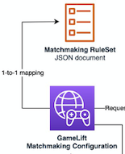
Architecture of GameLift
5. With the correct player data for any additional information, like player skill level, the Lambda function requests a match through FlexMatch matchmaking. FlexMatch allows you to define matchmaking configuration with JSON-based configuration documents. The game client can send latency data against the different Regions in addition to allowing latency-based matchmaking

Slide 34
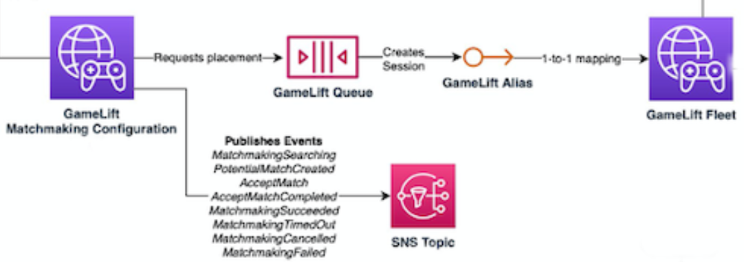
Architecture of GameLift
6. Once FlexMatch has matched a suitable group of players with proper latency to a Region, it will request a game session placement through a GameLift queue that has fleets with one or more Regional locations registered to it.
7. Once the session is placed on one of the fleets, an event notification is sent to an Amazon SNS

Slide 35
Architecture of GameLift
8. A Lambda function will receive the SNS event and process it.
9. If the ticket is a MatchmakingSucceeded event, the Lambda function writes the result to DynamoDB with the server port and IP. A time-to-live (TTL) value is used to make sure the tickets are deleted from DynamoDB when they are no longer needed

Slide 36
Architecture of GameLift
10. The game client makes a signed request to API Gateway to check the status of the matchmaking ticket on a specific interval.
11. A Lambda function for checking the matchmaking ticket status is invoked by API Gateway

Slide 37
Architecture of GameLift
12. From DynamoDB, the Lambda function checks if the ticket has already succeeded. In case it has, it will send the IP, port, and player session ID back to the client. Otherwise, it will send a response that the match is not yet ready.
13. The game client will connect to the game server using Transmission Control Protocol (TCP) or User Datagram Protocol (UDP) by using the port and IP provided by the backend. It will also send the player session ID to the game server, which can validate it using the GameLift Server SDK.

Slide 38
Code Snippet : Client
int main () {
// Create a credentials provider with the Cognito credentials to sign the requests
auto credentialsProvider = Aws::MakeShared<Aws::Auth::SimpleAWSCredentialsProvider>("api-gateway-client", credentials.GetAccessKeyId(), credentials.GetSecretKey(), credentials.GetSessionToken());
auto requestSigner = MakeShared<AWSAuthV4Signer>("", credentialsProvider, "execute-api", regionString);
// Create and sign the HTTP request
auto getGameSessionRequest = CreateHttpRequest(URI(backendApiUrl +"requestmatchmaking?latencies=" + latencies),
HttpMethod::HTTP_GET, Aws::Utils::Stream::DefaultResponseStreamFactoryMethod);
requestSigner->SignRequest(*getGameSessionRequest);
std::cout << "requesting matchmaking...\n\n";
// make the HTTP request
auto httpClient = CreateHttpClient(clientConfiguration);
auto requestMatchmakingResponse = httpClient->MakeRequest(getGameSessionRequest);
std::stringstream ss;
ss << requestMatchmakingResponse->GetResponseBody().rdbuf();
std::cout << ss.str() + "\n\n";
JsonValue matchMakingRequestJson = JsonValue(ss.str());
String ticketId = matchMakingRequestJson.View().GetString("TicketId");
std::cout << "Got Ticket ID: " << ticketId << "\n"; . . .
}

Slide 39
Code Snippet : Lambda Fn (requestMatchMaking.js)
const AWS = require('aws-sdk'); const GameLift = new AWS.GameLift({region: process.env.AWS_REGION}); const matchmakingConfigurationName = "ExampleGameConfiguration"; exports.requestMatchMaking = async (event) => { let response;
var playerSkill = null;
var ddb = new AWS.DynamoDB({apiVersion: '2012-08-10'});
// 1. Get the player data from DynamoDB
var params = {
TableName: 'GameLiftExamplePlayerData',
Key: {
'ID': {S: event.requestContext.identity.cognitoIdentityId }
}
};
await ddb.getItem(params).promise().then(data => {
if(data.Item != null && data.Item["Skill"] != null)
{
console.log("Success", data.Item["Skill"].N);
playerSkill = parseInt(data.Item["Skill"].N);
}
else
{
console.log("Player skill Data doesn't exist yet, will create");
}
}).catch(err => {
console.log("Couldn't access player data in DynamoDB: " + err);
});
// 2. Create player data if it doesn't exist
if(playerSkill == null)
{
playerSkill = 10; //The initial skill level
var params = { TableName: 'GameLiftExamplePlayerData',
Item: {
'ID' : {S: event.requestContext.identity.cognitoIdentityId},
'Skill' : {N: playerSkill.toString()}
}
};
// Call DynamoDB to add the item(Player) to the table
await ddb.putItem(params).promise().then(data => {
console.log("Success", data);
}).catch(err => {console.log("Error in put item:", err);});
} // Use the player's Cognito Identity as the ID
var playerId = event.requestContext.identity.cognitoIdentityId; // Get the latencies from query string
var latenciesString = event.queryStringParameters.latencies;
var latenciesList = latenciesString.split("_");
var regionLatencyMapping = {}
for(i = 0; i < latenciesList.length; i+=2)
regionLatencyMapping[latenciesList[i]] = latenciesList[i+1];
//Params for the matchmaking request
var params = {
ConfigurationName: matchmakingConfigurationName,
Players: [
{
LatencyInMs: regionLatencyMapping,
PlayerAttributes: { skill : { N: playerSkill } },
PlayerId: playerId
}
]
};

Slide 40
Code Snippet : Lambda Fn Contd… (requestMatchMaking.js)
// 3. Request matchmaking
await GameLift.startMatchmaking(params).promise().then(data => {
console.log(data);
response = {
"statusCode": 200,
"headers": {
},
"body": JSON.stringify(
data.MatchmakingTicket
),
"isBase64Encoded": false
};
}).catch(err => {
console.log(err);
});
//Return response if we got one
if(response != null)
{
return response;
}
//Send error response if not successful
response = {
"statusCode": 500,
"headers": {
},
"body": JSON.stringify({
message: "Unable to do matchmaking"
}),
"isBase64Encoded": false
};
return response;
};

Slide 41
Code Snippet : Client Contd…
int main () {
. . . // REQUEST MATCH STATUS UNTIL IT'S DONE , We’ll try 10 times with a 2s interval.
int tries = 0;
while(tries < 10)
{
// Create and sign the HTTP request
auto getMatchStatusRequest = CreateHttpRequest(URI(backendApiUrl + "requestmatchstatus?ticketId=" + ticketId),
HttpMethod::HTTP_GET, Aws::Utils::Stream::DefaultResponseStreamFactoryMethod);
requestSigner->SignRequest(*getMatchStatusRequest);
std::cout << "requesting match status...\n\n";
auto requestMatchStatusResponse = httpClient->MakeRequest(getMatchStatusRequest);// make the HTTP request
ss.str(""); //clear the string stream
ss << requestMatchStatusResponse->GetResponseBody().rdbuf();
JsonValue matchStatusResponseJson = JsonValue(ss.str());
String playerSessionId = matchStatusResponseJson.View().GetString("PlayerSessionId");
int port = matchStatusResponseJson.View().GetInteger("Port");
String ip = matchStatusResponseJson.View().GetString("IpAddress");
if(playerSessionId.compare("NotPlacedYet") == 0)
std::cout << "Not placed yet, try again in 2s\n\n";
else
{
std::cout << "Placement to session done! Connect to server and send player session ID\n\n";
int success = ConnectToServer(ip, port, playerSessionId);
break; // We're done, break out
}
tries++;
if(tries < 10)
sleep(2);
}
Aws::ShutdownAPI(options); //Shutdown the AWS SDK
return 0;
}

Slide 42
Code Snippet : Lambda Fn (requestMatchStatus.js)
const AWS = require('aws-sdk');
const GameLift = new AWS.GameLift({region: process.env.AWS_REGION}); exports.requestMatchStatus = async (event) => {
let response; //Get the ticket from request querystring
var ticketId = event.queryStringParameters.ticketId; console.log("Ticket id: " + ticketId); var ddb = new AWS.DynamoDB({apiVersion: '2012-08-10'}); // Try to get the ticket data from DynamoDB
var params = {
TableName: 'GameLiftExampleMatchmakingTickets',
Key: {
'TicketID': {S: ticketId }
}
};
await ddb.getItem(params).promise().then(data => {
if(data.Item != null)
{
console.log("Found Ticket")
ip = data.Item["ip"].S
port = parseInt(data.Item["port"].S)
playerSessionId = data.Item["playerSessionId"].S
dnsName = data.Item["dnsName"].S
var responsedata = {
IpAddress :ip,
Port : port,
PlayerSessionId : playerSessionId,
DnsName: dnsName
}
}
else //Matchmaking not succeeded yet
{
var responsedata = {
IpAddress : "",
Port : 0,
PlayerSessionId : "NotPlacedYet"
}
}
response = {
"statusCode": 200,
"headers": {},
"body": JSON.stringify(responsedata),
"isBase64Encoded": false
};
}).catch(err => {
console.log("Couldn't access ticket data in DynamoDB: " + err);
});
//Return response if we got one
if(response != null)
return response;
//Send error response if not successful
response = {
"statusCode": 500,
"headers": {},
"body": JSON.stringify({
message: "Unable to do matchmaking"}),
"isBase64Encoded": false
}; return response;
};

Slide 43
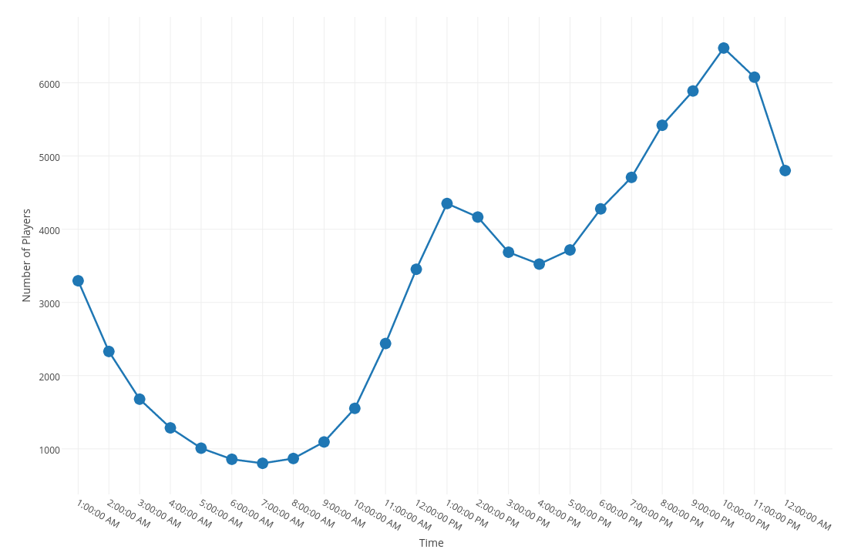
GameLift Pricing
This example uses a typical hourly player demand pattern for multiplayer games to illustrate Amazon GameLift pricing. Assuming, Region: Japan Players: 10,000 Instance Type: c4.xlarge on Linux. Where each c4.xlarge instance can run 4 games with up to 10 players simultaneously. Throughout the day, you will need more or less capacity, from 7:00 am to 8:00 am you will need 20 instances to meet player demand (800 concurrent players / 10 players per game / 4 games per instance = 20 instances) Similarly, from 10:00pm-11:00 pm need 162 instance. The sum of all instances running each hour over the entire 24-hour period is 1,944 instance hours.

Slide 44
GameLift Pricing
On-Demand instances, Charge $0.311 per instance hour (c4.xlarge instance running Linux in the Asia Pacific (Tokyo) region) Your total daily usage of 1,944 hours at $0.311 per hour sums to $605 per day, $18,150 per month.
On Spot instances, Spot instances running Linux are on average 70% cheaper than the same On-Demand instances. $181 per day, $5,430 per month. Data Transfer
We'll assume that the total amount of monthly data transfer in the AWS Asia Pacific (Tokyo) region from all of your game servers to your game clients is 49.82 terabytes per month. Based on standard Data Transfer rates in the AWS Asia Pacific (Tokyo) region, your cost for 49.82 terabytes of data transfer is $6,776 per month.

Slide 45
What is Playfab ?
PlayFab is a complete backend platform for live games with managed game services, real-time analytics, and LiveOps.
PlayFab's backend services reduce the barriers to launch for game developers, offering both large and small studios cost-effective development solutions that scale with their games and help them engage, retain, and monetize players.
PlayFab enables developers to use the intelligent cloud to build and operate games, analyze gaming data and improve overall gaming experiences.

Slide 46
Multiplayer services
1. Cross Network Identity and Data
Player Authentication: Start with frictionless authentication and let players link accounts to roam across Windows, Xbox, Steam, PlayStation™Network, Nintendo, Facebook, iOS, Android, and more.
Player Data Management: Share player information and game state across devices.
Matchmaking - Use the proven capabilities of Xbox Live's SmartMatch on any platform to help players find opponents.

Slide 47
Multiplayer services
2. Multiplayer Servers
Dedicated Servers: Deliver low-latency real-time gameplay for any platform.
24/7 Monitoring and DDoS Protection - Protect against DDoS attacks and other incidents.
Global Reach with Microsoft Azure: Get closer to players on a cloud with more global regions than any other provider.
Control Costs: Dynamically scale server cores in response to demand.

Slide 48
Multiplayer services
3. Chat
Party: Connect players with low-latency peer-to-peer communication.
Text and Voice Chat: Facilitate accessible voice chat, transcription, and translation.
Accessibility: Use automated speech-to-text transcription and voice synthesis to make communication simple for everyone.
Real-Time Translation: Break down global barriers and grow player concurrency by translating voice and text chat between more than 30 different languages.
Encryption: Ensure secure player communications.

Slide 49
Multiplayer services
4. Leaderboard and Statistics
Tournaments and Leaderboards: Facilitate permanent or time-limited competitions amongst friends or strangers.
Scheduling: Reset leaderboards on a schedule and archive standings so players can view past results.
Prizes: Reward players based on their actions and leaderboard ranks.
Cheat Prevention: Defend against unwanted behavior and remove fraudulent players and accounts.

Slide 50
Setting Up PlayFab Multiplayer Servers Hosting
1. Build Your Game Server: o Create a game server build containing your game's executable and assets. o Integrate the PlayFab Game Server SDK for seamless operation on PlayFab servers.
2. Deploy Your Build: Configure PlayFab to create and manage virtual machines (VMs) for your game servers. Specify server types, regions, scaling options, and pre-allocated resources.
3. Scale Servers Automatically: PlayFab dynamically adjusts VMs based on player demand like Standby servers for waiting players, Scaling up during peak times,Recycling used VMs for efficiency . 4. Measure Player Latency (Optional): Use PlayFab's QoS beacons to measure player latency to different Azure regions.This helps select the best region for optimal gameplay experience.
5. Request Game Servers: Players, matchmaking, or your own system can request game servers from PlayFab.
6. Connect and Play! PlayFab allocates servers within seconds (if available).Clients connect to the allocated server and start playing your game.

Slide 51
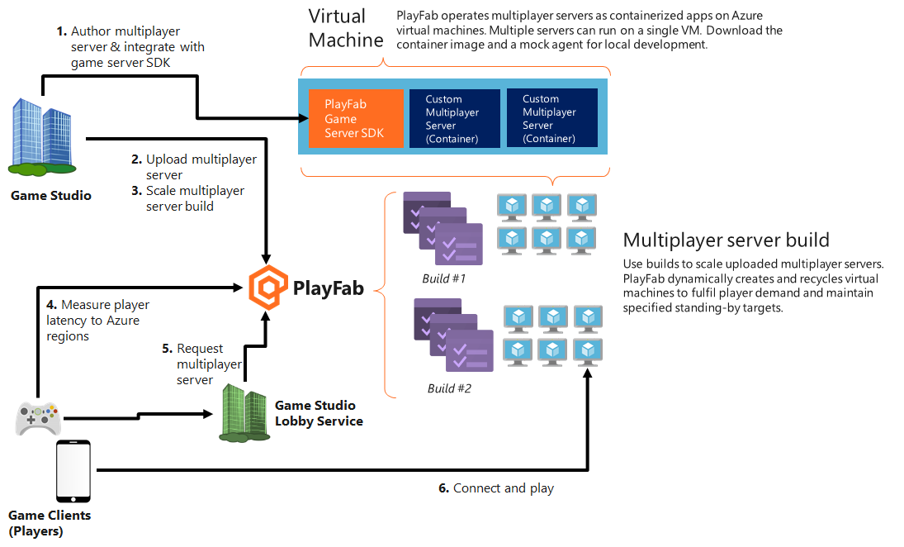
Working of PlayFab Multiplayer Servers Hosting

Slide 52
Additional Features
Friends: Players can add each other as friends, enabling features like:Seeing each other's online status.Sending private messages.Inviting friends to join games or parties. Groups, Guilds, and Clans : you can use Shared Group Data to share information among a limited number of players. Tournaments and Leaderboards: Create competitive experiences with leaderboards to showcase player achievements and rankings. Tournaments allow you to organize structured competitions with defined rules and rewards. Trading: You can build a trading system using its virtual currencies, items, and catalog features. Players could trade items for virtual currency or other items within the game's economy. Push Notifications and In-Game Messages: Send targeted messages to players to drive engagement, such as reminding them about events, daily rewards, or special offers

Slide 53
Additional Features
PlayStream : Get a real-time view of events happening in your game, enabling you to react quickly to player actions, identify issues, or trigger in-game events based on specific criteria. Telemetry : It’s a feature of PlayFab that allows you to send UserGenerated Events to PlayFab and is useful for recording things that are happening inside your game, without the need of immediately reacting to them. For example record crash logs, performance metrics, user behavior. Experimentation : PlayFab allows you to experiment with different game features, content variations, and monetization strategies to see which ones perform better with your player base. Segmentation : Lets you create targeted groups of players based on their player properties. When PlayStream events are processed, your configuration drives the addition of players into and out of the segments you define. Let's say that you want to define a segment of players where XP > 3,000, If the condition (> 3000) evaluates to true, then the player enters the High XP Players segment, and the corresponding action(s) will be triggered. There are various basic actions available, including granting an item to the player, granting virtual currency, changing a statistic, banning a player, sending a player an email or sending a Push notification.

Slide 54
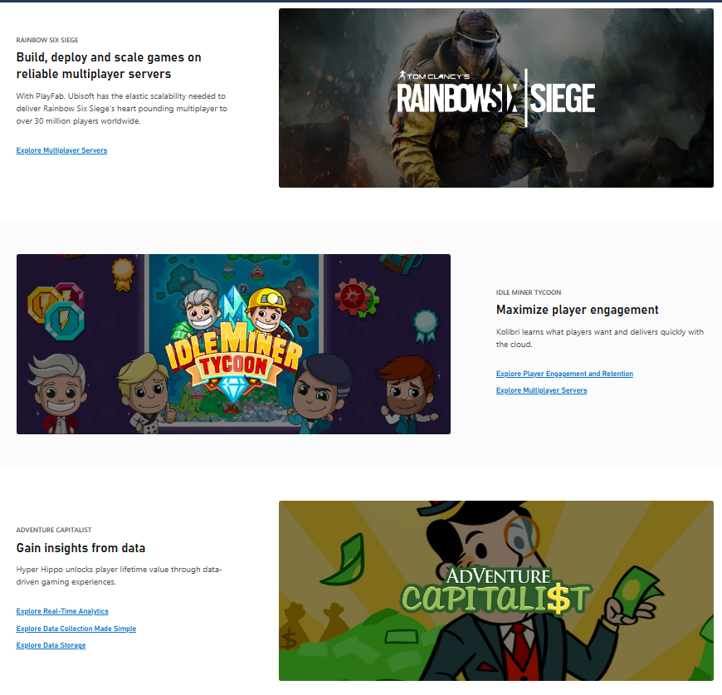
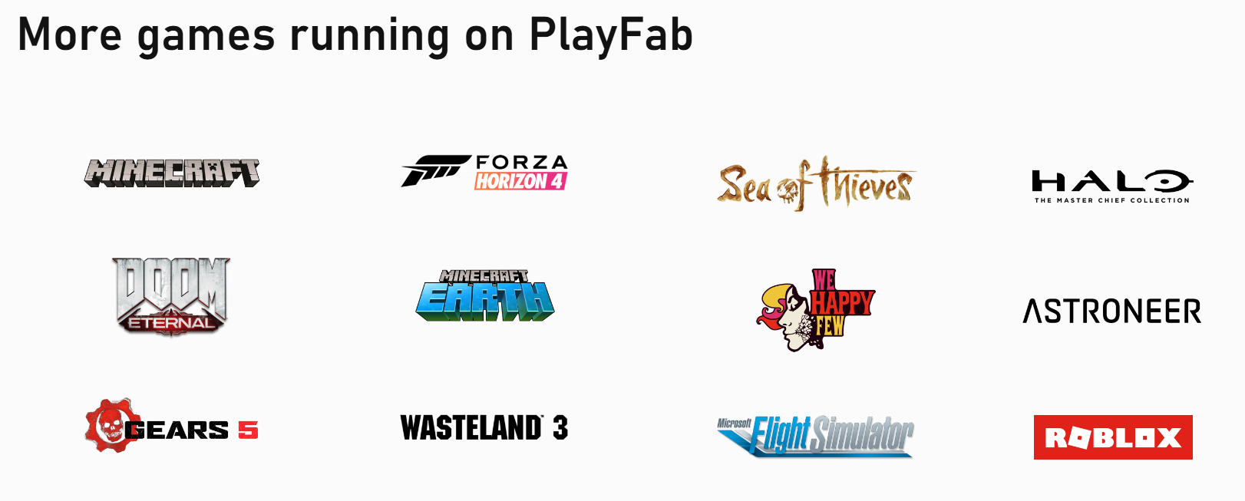
Games running on PlayFab

Slide 55
Thanks!

